Slide 1

Data-Driven Atom-Level Explanation of Polymer Properties
Yuhao Liu, Jiahui Yang
Department of Mechanical Engineering
University of Wisconsin – Madison
December 01, 2024

Slide 2
Contents
Introduction & Problem Statement
Research Methods & Model Settings
Results & Discussion
Conclusion
Q&A

Slide 3
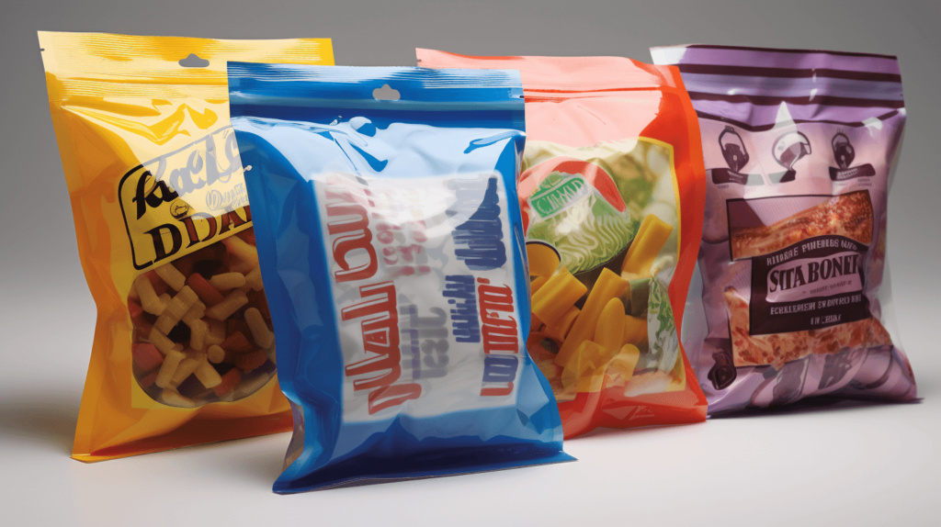
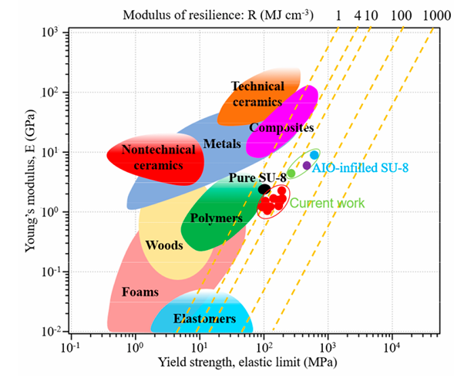
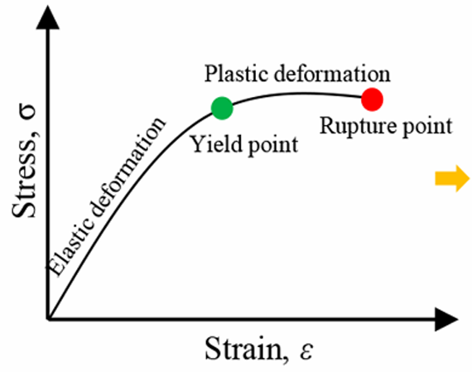
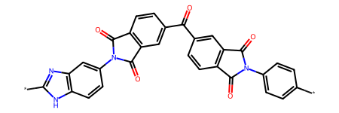
Introduction
Widespread Applications of Polymers
Challenges:
Complex molecular structures & chain configurations
Microstructure influences their mechanical properties
Monomer
[1] Yue, Tianle, et al. Journal of Chemical Theory and Computation 19.14 (2023): 4641-4653.

Slide 4
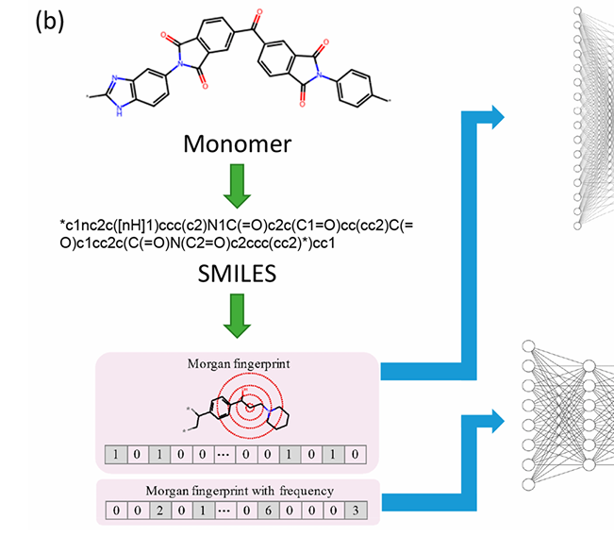
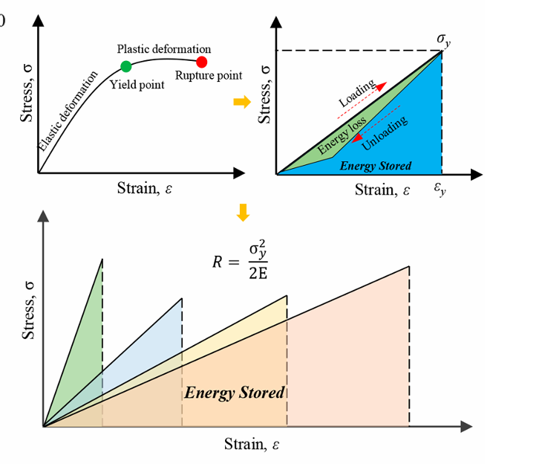
Problem Statement
Machine Learning in Materials Science
An essential tool for property prediction
Fail to capture the intricate details of polymer chains (topological information), such as SMILES
Require validation through other methods, such as MD simulations

Slide 5
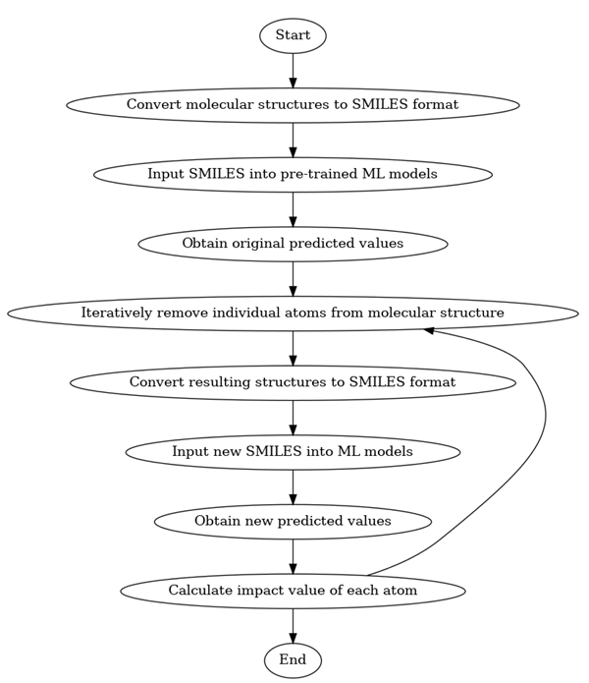
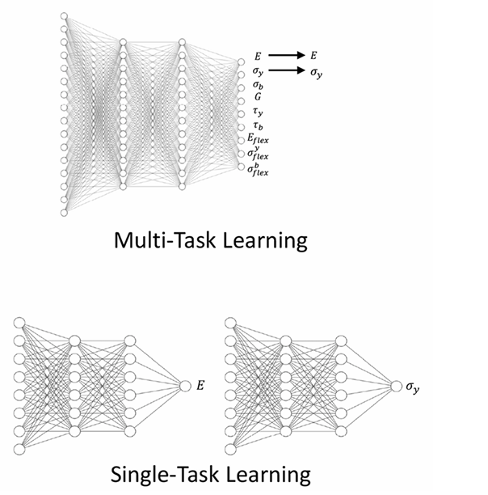
Research Methods & Model Settings
A single-task machine learning model is employed to explore the relationship between polymer microstructures and macroscopic properties.

Slide 6
Research Methods & Model Settings
Data Source:
Data was sourced from PoLyInfo ^{[2]}, a comprehensive database containing information on over 18,000 polymers, including 923 homopolymers with documented Young’s modulus values.
SMILES ^{[3]} strings were used as input to the ML model to represent the chemical structure of polymers.
[2] Otsuka, Shingo, et al. 2011 International Conference on Emerging Intelligent Data and Web Technologies. IEEE, 2011.
[3] Weininger, David. Journal of chemical information and computer sciences 28.1 (1988): 31-36.

Slide 7
Research Methods & Model Settings
Convert molecular structures into SMILES
Train the ML model using SMILES and corresponding Young's modulus values
Iteratively remove atoms and recalculate predictions to evaluate atomic-level contributions
SHAP (Shapley Additive Explanations) values reveal substructure contributions to ML predictions
Atom-level explanations map prediction changes from atom removal

Slide 8
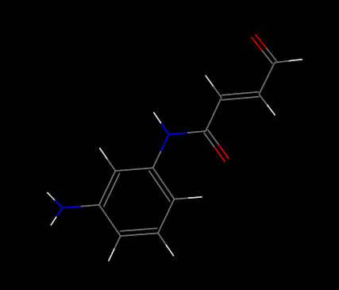
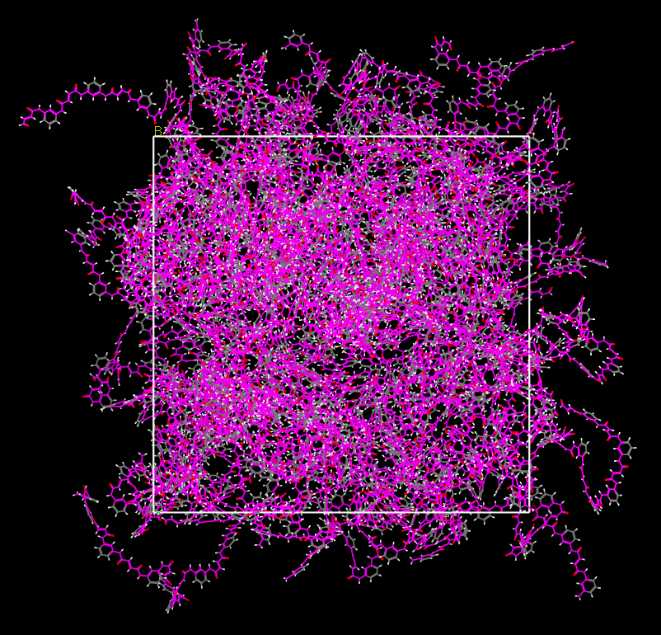
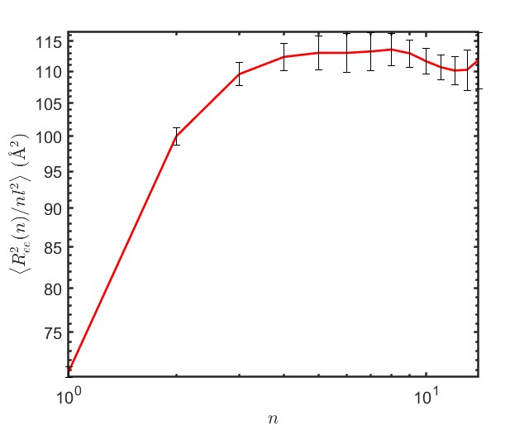
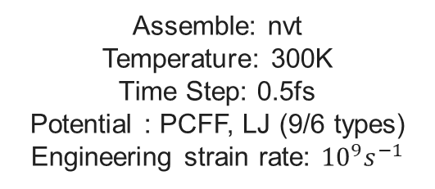
Research Methods & Model Settings
Step 1 Model Establishment
(Materials Studio)
Step 2 Relaxation
(LAMMPS)
Step 3 Tension
(LAMMPS)
1. Relaxation
Assemble: npt
Temperature: 650K, Time step: 0.5 fs
2. Anneal
Assemble: npt
Temperature: 650K → 300K, Time step: 0.5 fs
3. Relaxation
Assemble: npt
Temperature: 300K, Time step: 0.5 fs
Assemble: nvt
Temperature: 300K
Time Step: 0.5fs
Potential : PCFF, LJ (9/6 types)
Engineering strain rate: ${10}^{9}s^{−1}$
Monomer
Number of chains 80
Length of chains 15

Slide 9
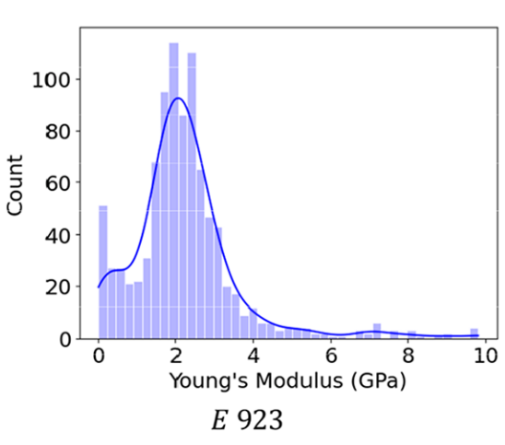
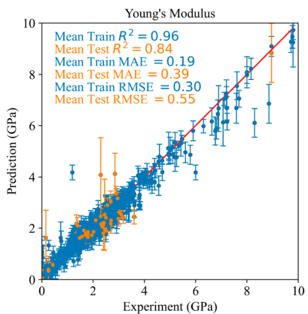
Results & Discussion

Slide 10
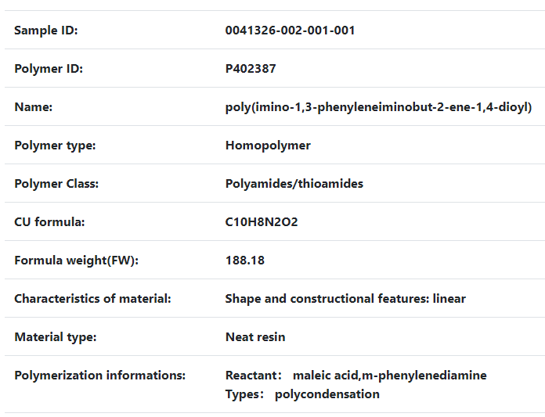
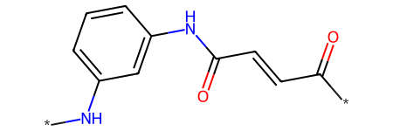
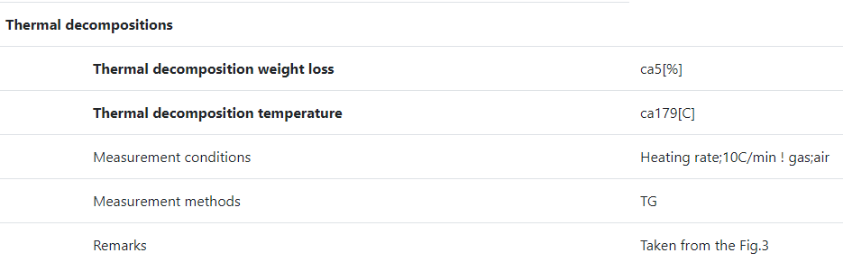
Results & Discussion
[4] Rabie, S. T.; Eid, M. A. M.,Journal of Vinyl & Additive Technology,13,4,206-214,2007,10.1002/vnl.20129

Slide 11
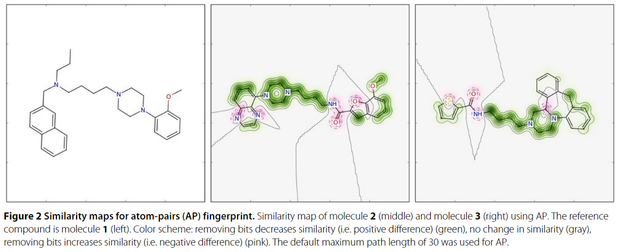
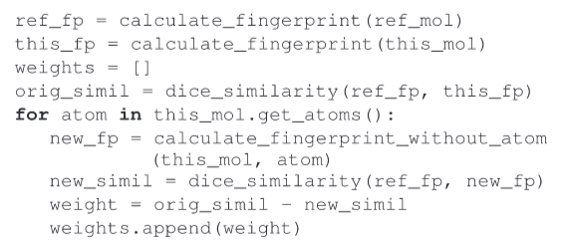
Results & Discussion
ref_fp = this_fp
Prediction property
single-task model
weight=ML(ref_fp)- ML(new_fp)
[5] Riniker, Sereina, and Gregory A. Landrum. Journal of cheminformatics 5 (2013): 1-7.

Slide 12
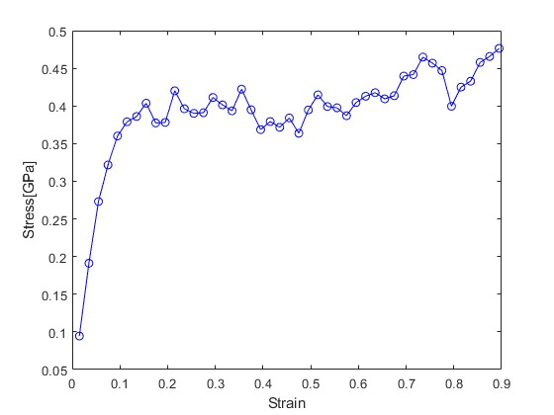
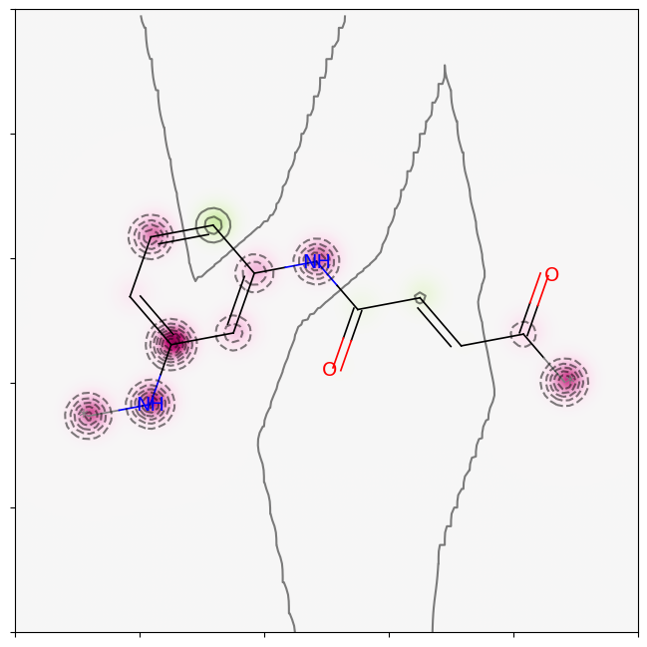
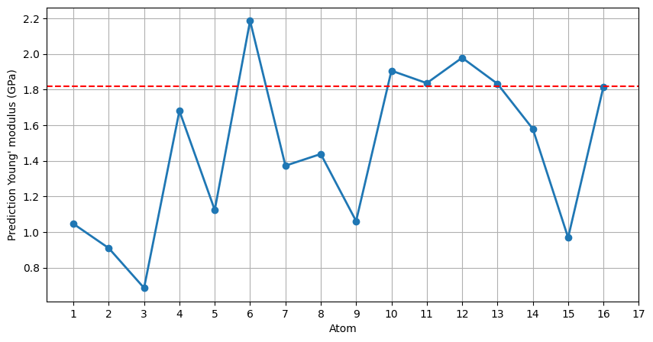
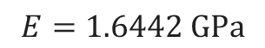
Results & Discussion
$$E=1.6442 GPa$$
(a)
(b)
5
6
7
16
4
10
12
3
8
13
14
1
11
15
2

Slide 13
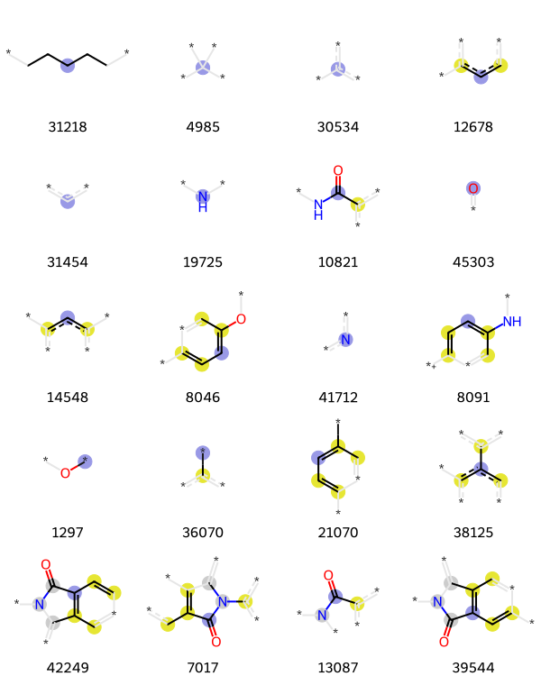
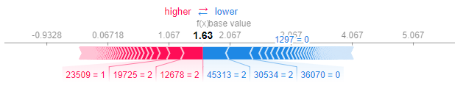
Results & Discussion(SHPB value)
N
H
*
*
*
*
23509
19725
12678
45313
30554

Slide 14
Results & Discussion

Slide 15
Conclusion
The single-task neural network model outperforms molecular dynamics simulation in predicting elastic modulus, with only an 8% prediction error.
SHAP values calculated using the single-task machine learning model reveal key impacts of polymer substructures on performance, though some findings are inconsistent with atom-level explanations.

